Slide 1


Airline Management System

Slide 2
Index
Introduction
Tech Stack
Workflow
Working
Output
Conclusion
Reference

Slide 3



Introduction
Project overview
Java-based airline management system
Desktop app with Swing GUI+ MySQL
Manage bookings, cancellations, flight & aircraft
Problem Statement
Manual operations cause delay and errors
Lack of centralized, real-time data
Growing complexity with airline scale
Objectives
Automate flight & booking operations
User-friendly booking for passengers
Admin control over flight & reports
Scalable, consistent MySQL database

Slide 4



Tech Stack
Java - core language for backend logic
Swing - GUI framework for desktop UI
VS Code - code for development
Git/ Github -
MySQL - For persistent, structured data storage
MySQL command line - For database handling

Slide 5
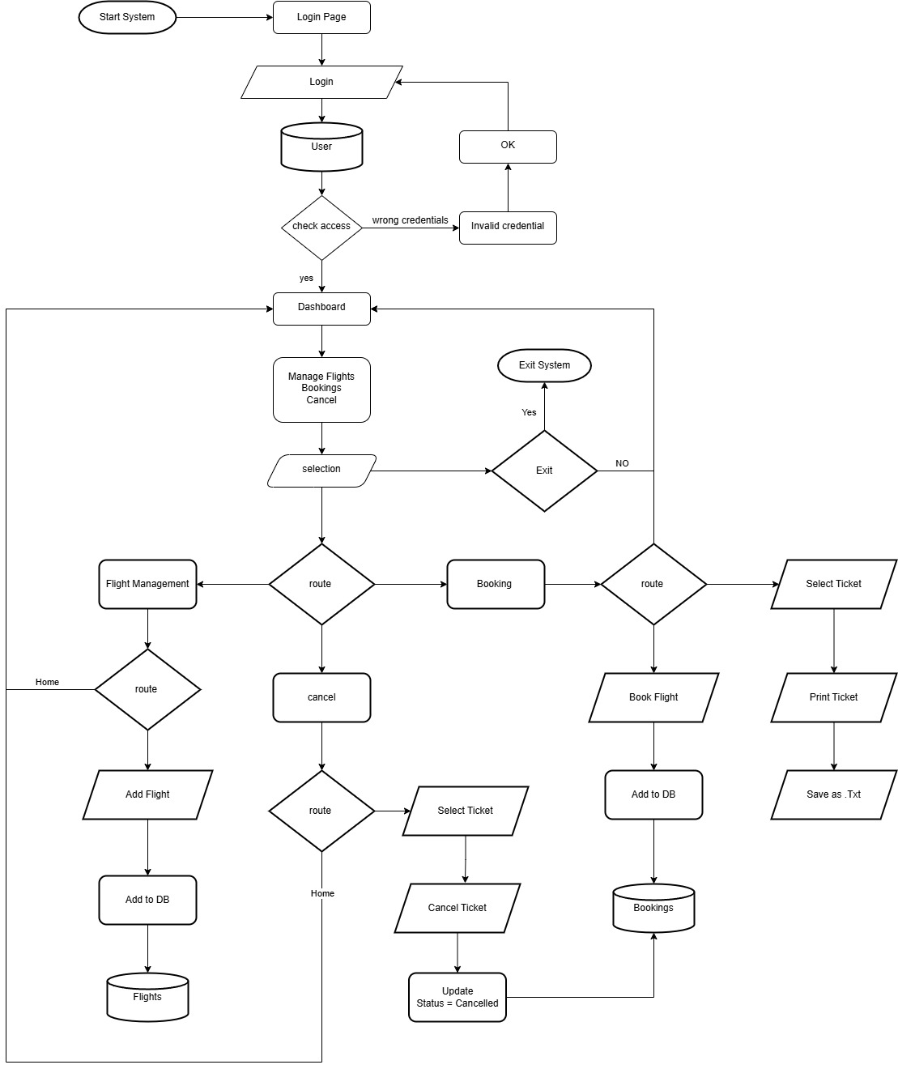
Workflow

Slide 6
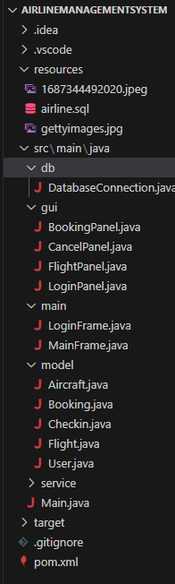
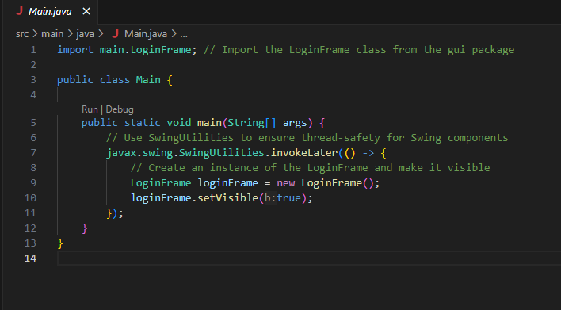
Working
This Java snippet launches a LoginFrame GUI window on the Event Dispatch Thread using SwingUtilities for thread safety.

Slide 7
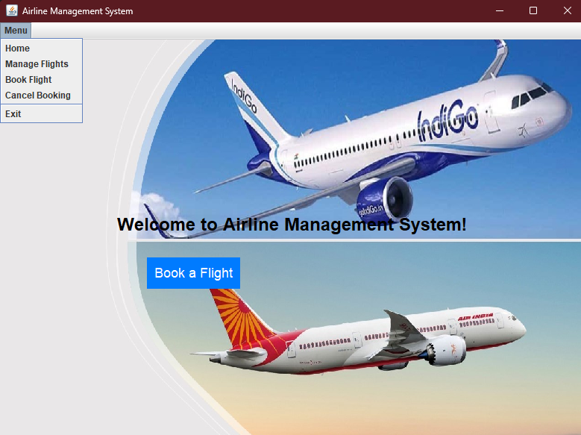
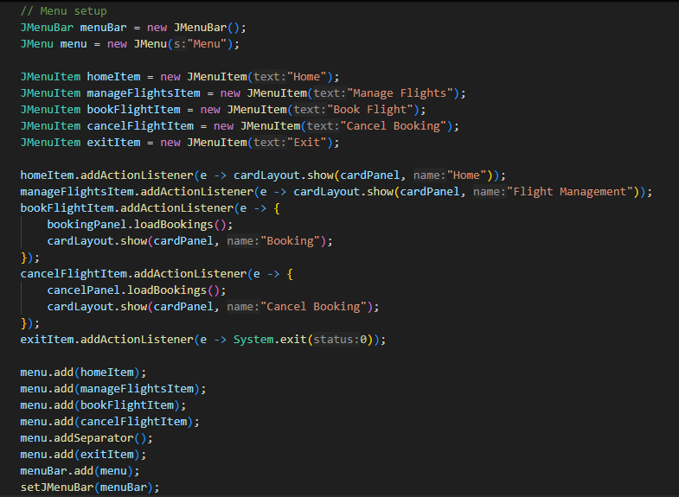
Working

Slide 8
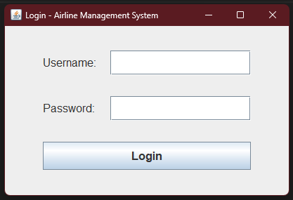
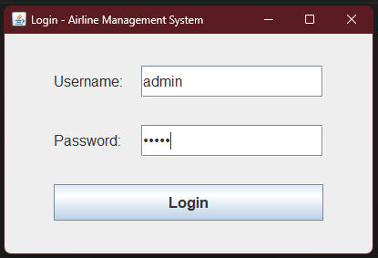
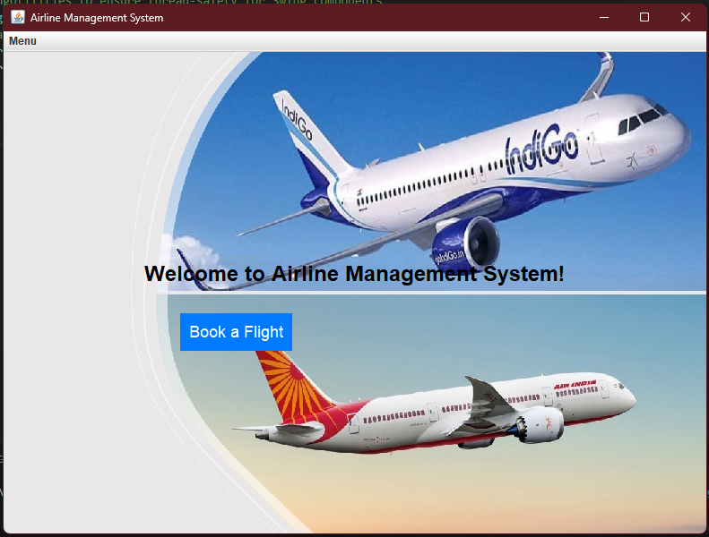
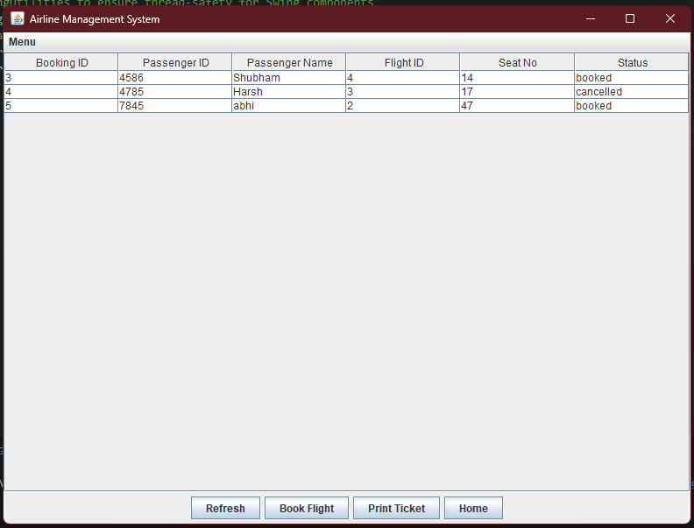
Output

Slide 9
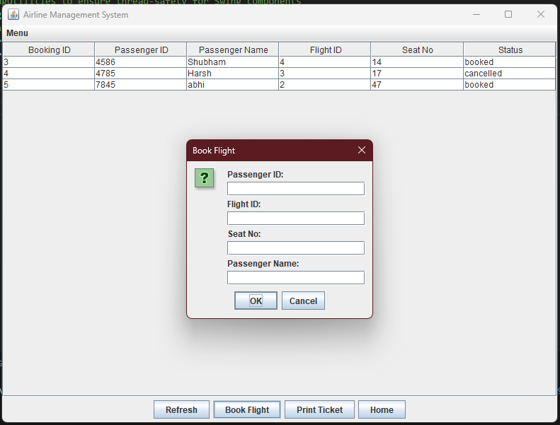
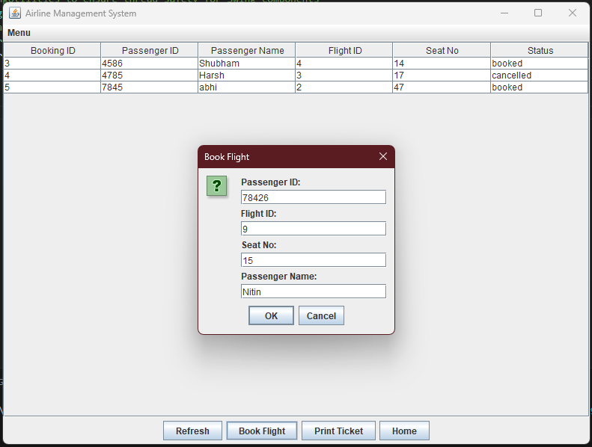
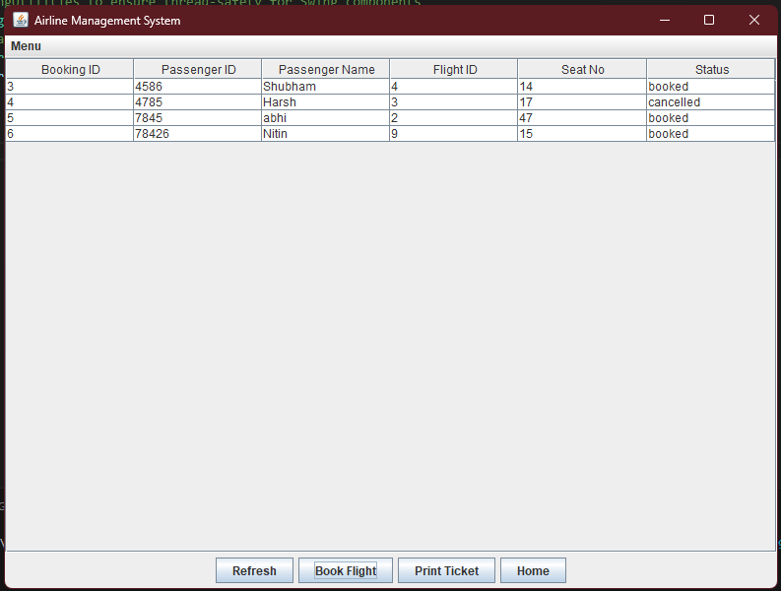
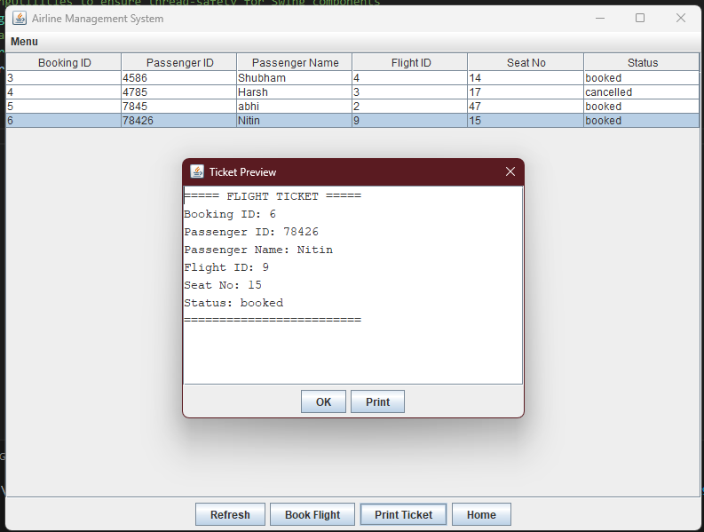
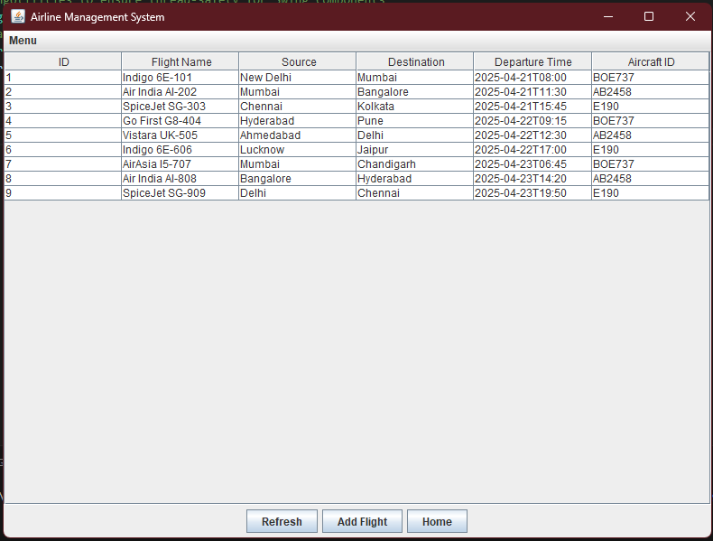
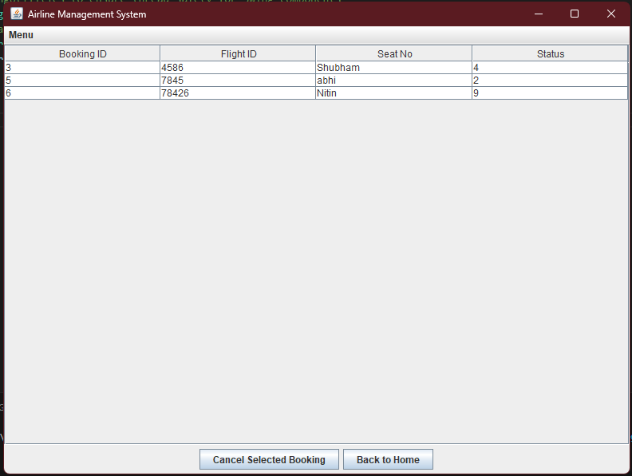

Slide 10
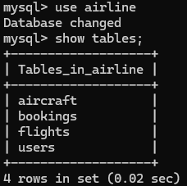
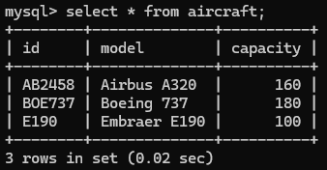
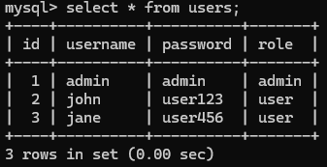
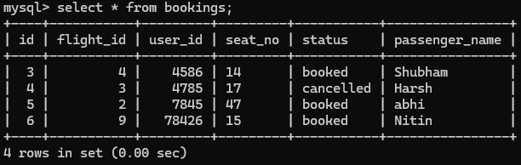
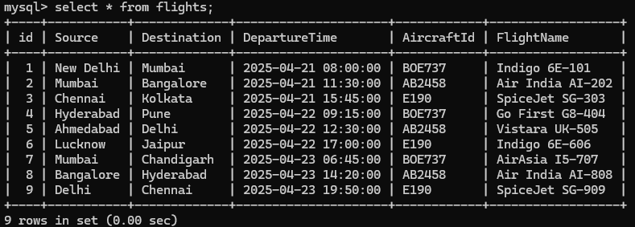

Slide 11


Conclusion
Achievements:
Fully functional airline booking.
MySQL integration wit data storage
Use of Swing-based UI
Learnings
JDBC and Swing integration
Practical experience in SQL queries and error handling

Slide 12
Reference
https://docs.google.com/document/d/14KgKkV8mTrtGgCYVRhL8RrG2N1UCxNur/edit?tab=t.0
https://developers.redhat.com/products/openshift/getting-started
https://www.youtube.com/watch?v=KC9CeYs36uA&list=PL_6klLfS1WqG2JM6fFFWGlhLJLCB5mr7T

Slide 13
Members
Shubham Swain
Mahi Agarwal
Harsh Agarwal
Shubhi Raj Saxena
Satpreet Kaur
Archie chawala

